Slide 1


Embedding UK Business Using Diverse Data

Slide 2
Aim and objectives
Agenda
Task implementation
Challenges and limitations
Engagement with the client
Future steps

Slide 3
Aim and objectives
Scrape the companies information (structured & unstructured)
Embedding the companies in form of vectors
Modelling and visualization of similar business
Create a search tool

Slide 4
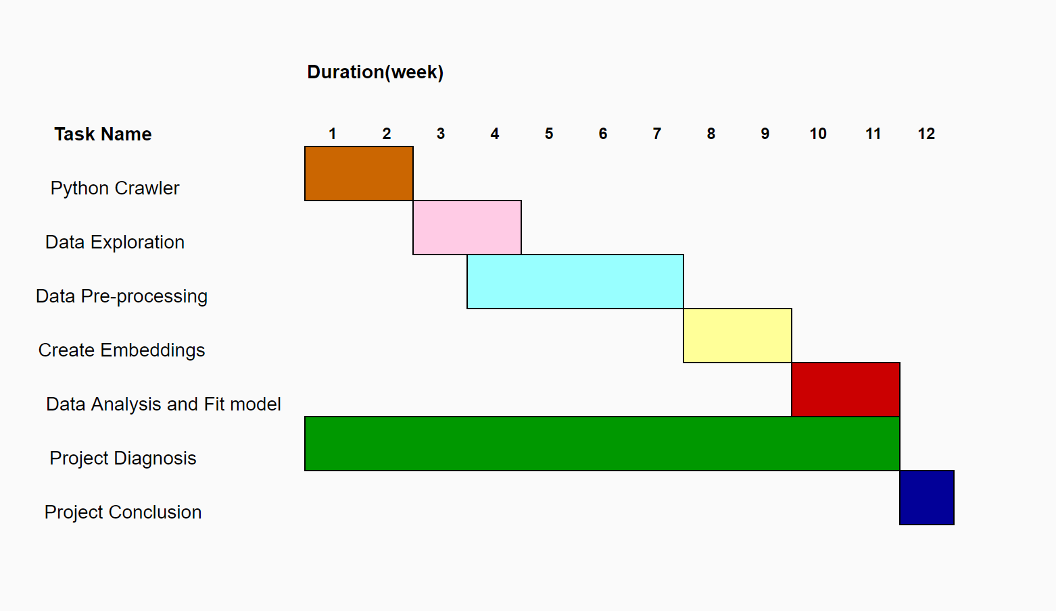
Task implementation - Gantt Chart

Slide 5
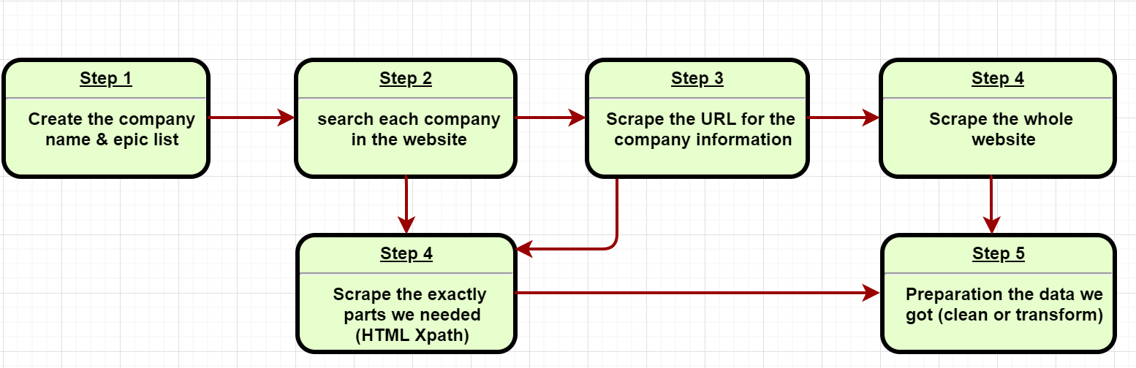
Scraping the data
Scraping structured and unstructured data of the FT250 companies
Website: FT.Com , Telegraph.co.uk , stockmarketwire.com , wikipedia.org

Slide 6
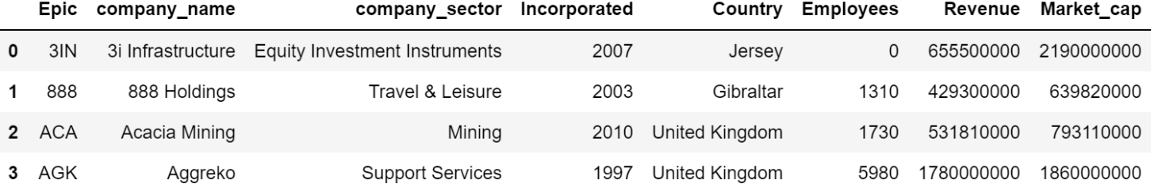
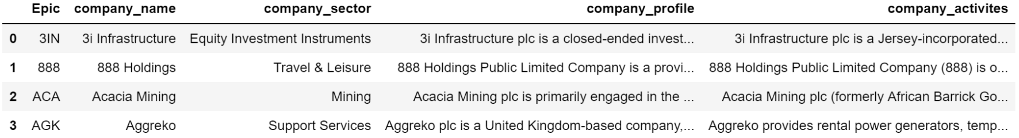
Progress, limitations, challenges
Structured data:
Unstructured data: company brief description, company activities, company recent 10 news
Limitation & Challenges:
Many missing values for structured data
News are limited and mostly only contain information about financial information
The websites are varied for each company (different web structures）
Many useless information were scraped and it has to be properly cleaned

Slide 7
Twitter Data
The Process
Extract information about the companies from individual company's Twitter profile
Create a pandas data frame from text in tweets, date created, retweet count, likes, source and place(depends on if the sources enable location services)
Exploratory analysis on the data frame
Limitations Challenges
Due to the vast amount of information on twitter, irrelevant information are downloaded
Increase in computational time due to the high number of tweets being extracted
Tedious data carpentry

Slide 8
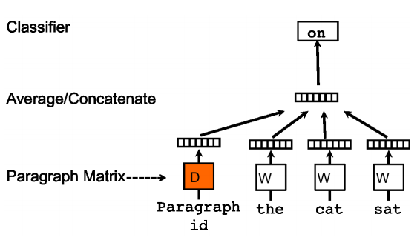
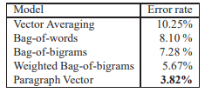
Embedding documents
Doc2vec
- unsupervised algorithm
- from variable-length pieces of texts to fixed-length feature representations (i.e.,vectors)
Embedding each UK companies to a vector according their description textual data
The state-of-art method
The Distributed Memory Model of Paragraph Vectors (PV-DM)
Doc2vec Paper: https://arxiv.org/pdf/1405.4053.pdf

Slide 9
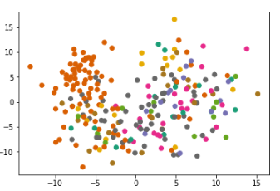
Modelling progress, limitations
The similar companies with 3i Infrastructure (Equity Investment Instruments):
Name Sector Similarity 0 GCP Infrastructure Investments Equity Investment Instruments 0.862 1 Sequoia Economic Infrastructure Income Fund Equity Investment Instruments 0.844 2 International Public Partnership Equity Investment Instruments 0.812 3 Riverstone Energy Limited Equity Investment Instruments 0.799 4 Greencoat UK Wind Equity Investment Instruments 0.798 5 NB Global Floating Rate Inc Fund £ Equity Investment Instruments 0.710 6 VinaCapital Vietnam Opp. Fund Equity Investment Instruments 0.709 7 HICL Infrastructure Co Equity Investment Instruments 0.706 8 Acacia Mining Mining 0.678 9 The Renewables Infrastructure Group Equity Investment Instruments 0.664
cosine distance
Equity Investment Instruments
PCA -2
The embedding vector of 3i Infrastructure:
From text to 20-length vector
Limitation: the textual data is not enough to be represented a better vector by Doc2vec
[-0.7537234 -1.3469197 4.886417 0.65664333 -3.1610901 1.0206047 -4.9388328 4.4806123 -4.799124 -2.2679093 -0.63176906 0.54223734 5.3173127 4.1309824 7.312767 0.49713486 6.6712184 3.148123 2.2504528 5.744295 ]

Slide 10
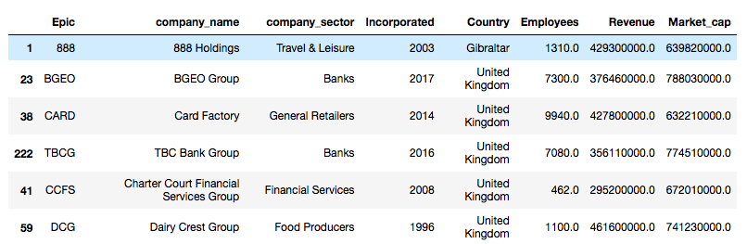



Creating search tool
Defining the similarities (Market value, Popularity, Description and News)
Generalizing for all UK companies
Limitations:
No information about all 2 mil. companies from chosen website
Cannot combine the scraping information and modelling parts
Search tool limited to only existing scraped system of companies
Arbitrary objects

Slide 11
Future Steps
AI | Consider more textual data into the model Other embedding methods like latent semantic analysis (LSA) Other Measurement of similarity such as Jaccard distance Visualization
Kyle | Company news file preparation Data preprocessing Scarpe more information if needed
Diep | Structured Data Analysis Create a search tool (FT250) Generalization (All UK Companies ?, arbitrary objects ?)
Israel | Twitter data preparation EDA about twitter
Tiffany | Project management Contact with client Report Structure

Slide 12
Thanks
Question Time

